Slide 1
Quality control in OBIS
Pieter Provoost
IOC-UNESCO

Slide 2
Quality control in OBIS
Who does QC?
Data provider
Tier 2 OBIS nodes
Tier 1 OBIS node
Reject records or values
Tier 1 to provide guidelines, tools, and services
What needs to be checked?
Standards compliance
OBIS required fields present?
Values formatted correctly?
Do the values make sense?
tier 1
tier 2
provider

Slide 3
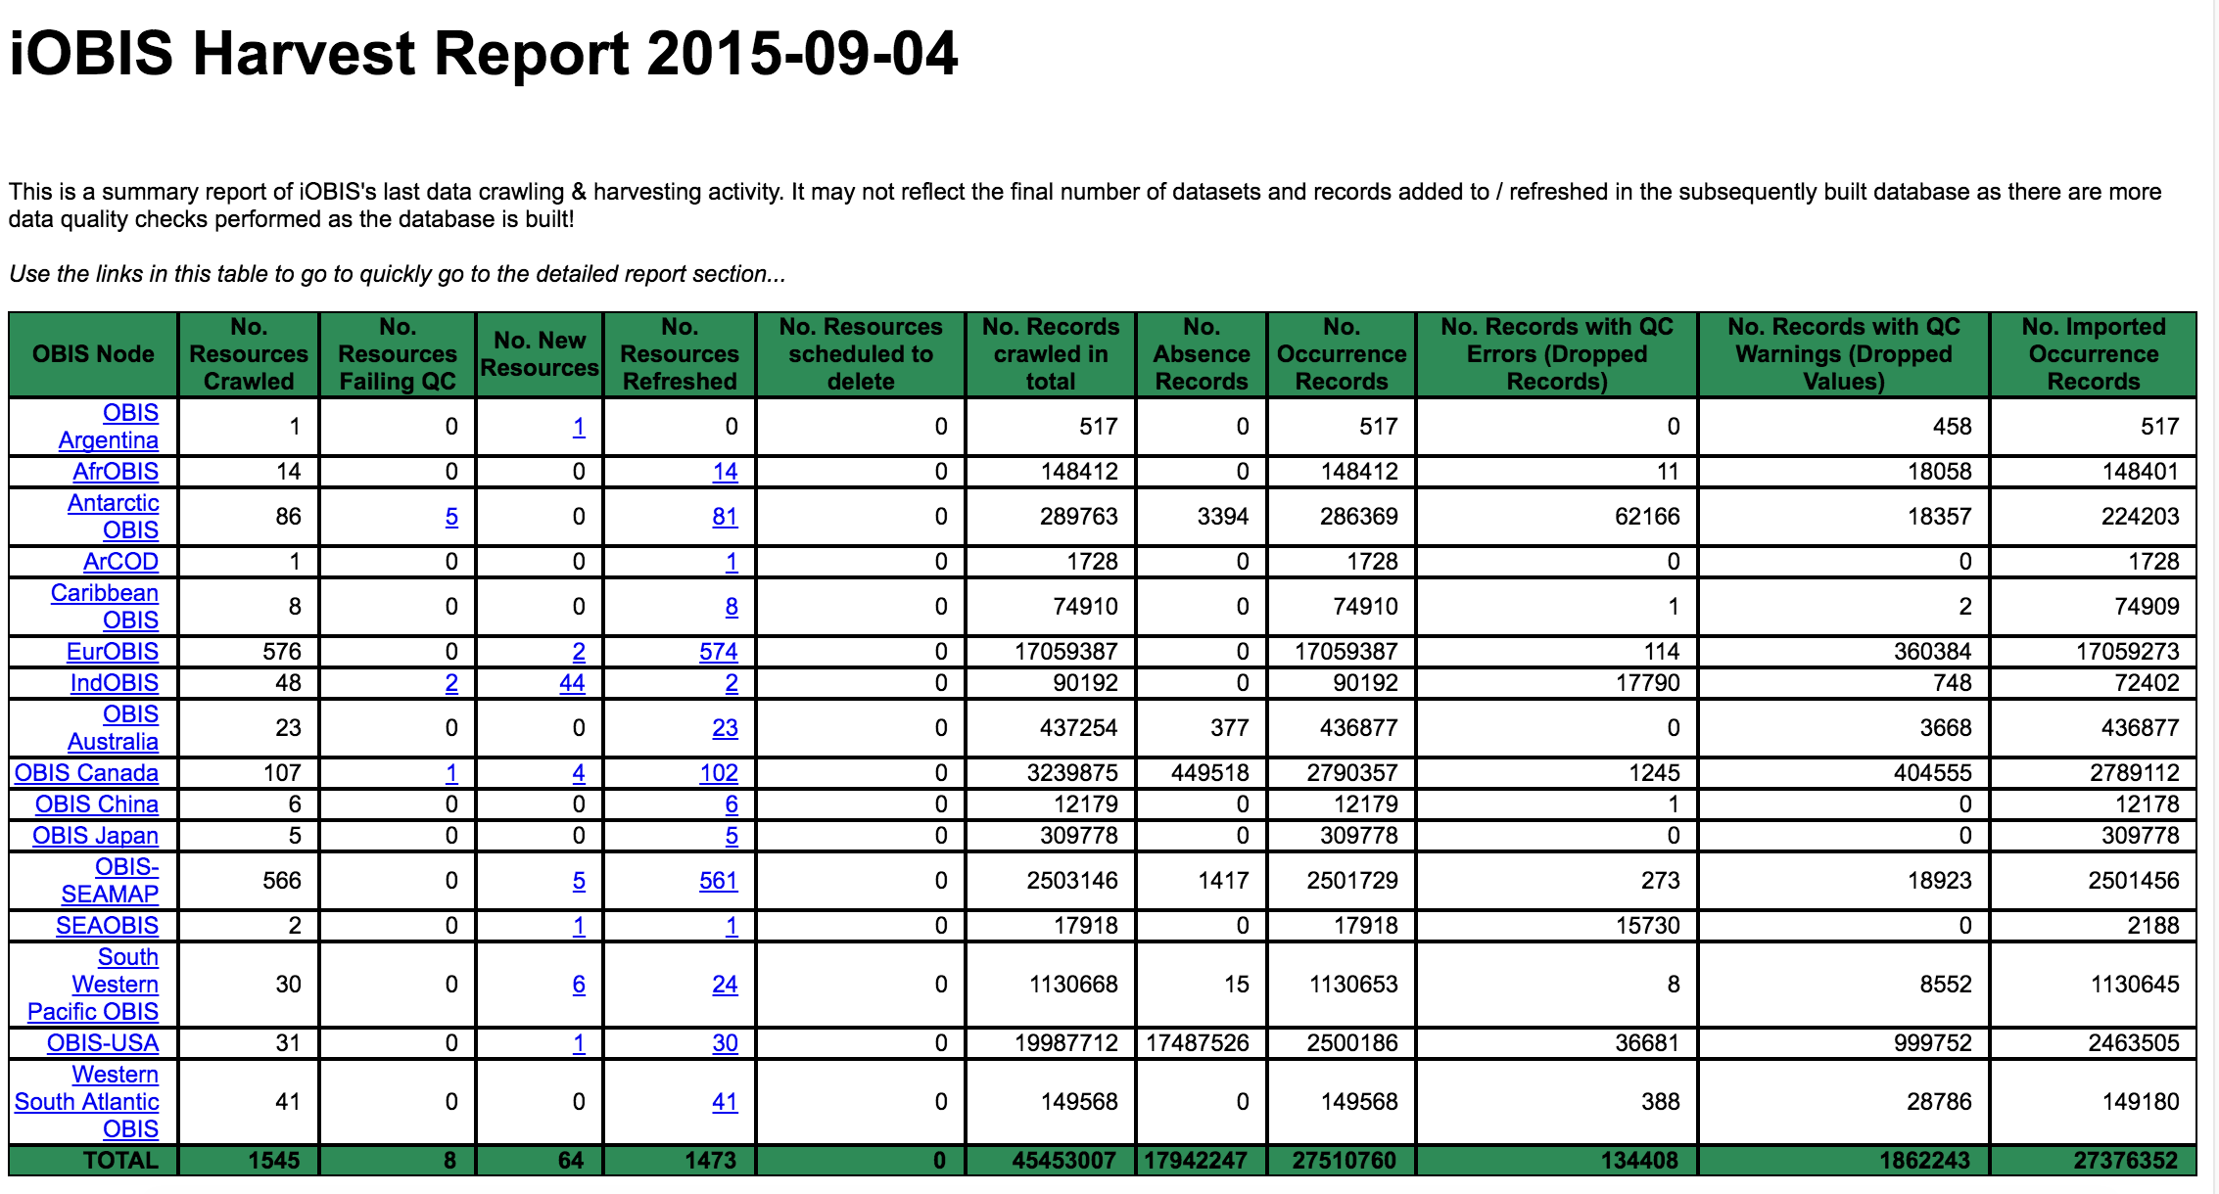
Quality control in OBIS

Slide 4
Quality control in OBIS
Standards: Darwin Core (DwC)
Managed by TDWG (Biodiversity Information Standards)
Terms: http://rs.tdwg.org/dwc/terms/
Guidelines on how to use these terms in XML, CSV, etc.
http://beta.iobis.org/manual/darwincore/
"OBIS schema" no longer used

Slide 5
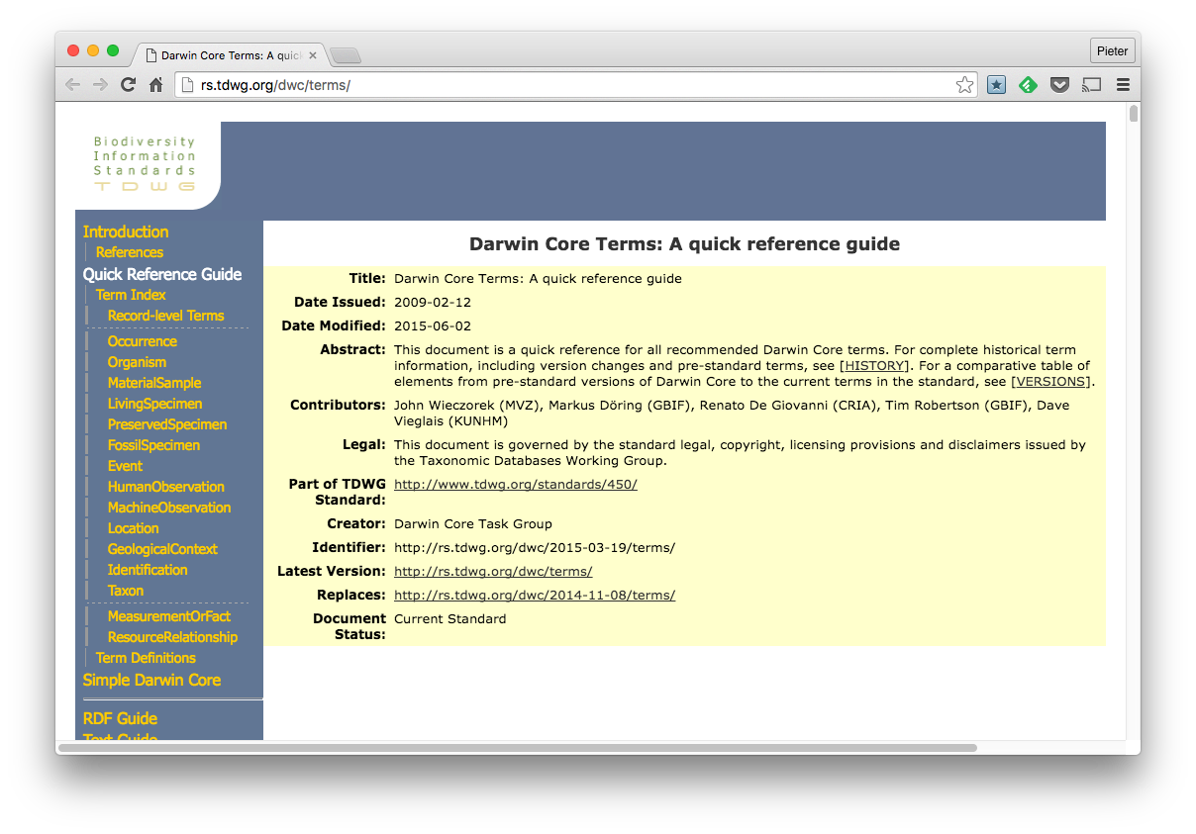
Quality control in OBIS

Slide 6
Quality control in OBIS
Standards: Darwin Core Archive (DwC-A)
http://rs.gbif.org/
Managed by GBIF (Global Biodiversity Information Facility)
Single self-contained dataset
Archive descriptor, metadata and data files

Slide 7
Quality control in OBIS
OBIS required terms
eventDate (when?)
decimalLatitude, decimalLongitude (where?)
scientificName, scientificNameID (what?)
Keep original name!
occurrenceStatus (present or absent?)
basisOfRecord (DwC-A required field)

Slide 8
Quality control in OBIS
OBIS required terms
eventDate (when?)
decimalLatitude, decimalLongitude (where?)
scientificName, scientificNameID (what?)
Keep original name!
occurrenceStatus (present or absent?)
basisOfRecord (DwC-A required field)

Slide 9
Quality control in OBIS
Date and time
ISO 8601
1973-02-28T15:25:00
1973-02-28T15:25:00Z (UTC)
1993-01-26T04:39+12/1993-01-26T05:48+12
2015-023
2014-W26

Slide 10
Quality control in OBIS
Not ok:
2015/07/11
09-Dec-2009
10/01/2013
1:25
Jan
1915-6-9 0:00:00
1995-7-0
00:18:00+0:00

Slide 11
Quality control in OBIS
Location related terms:
decimalLatitude
decimalLongitude
coordinateUncertaintyInMeters
geodeticDatum (EPSG:4326)
footprintWKT
minimumDepthInMeters
maximumDepthInMeters
locality

Slide 12
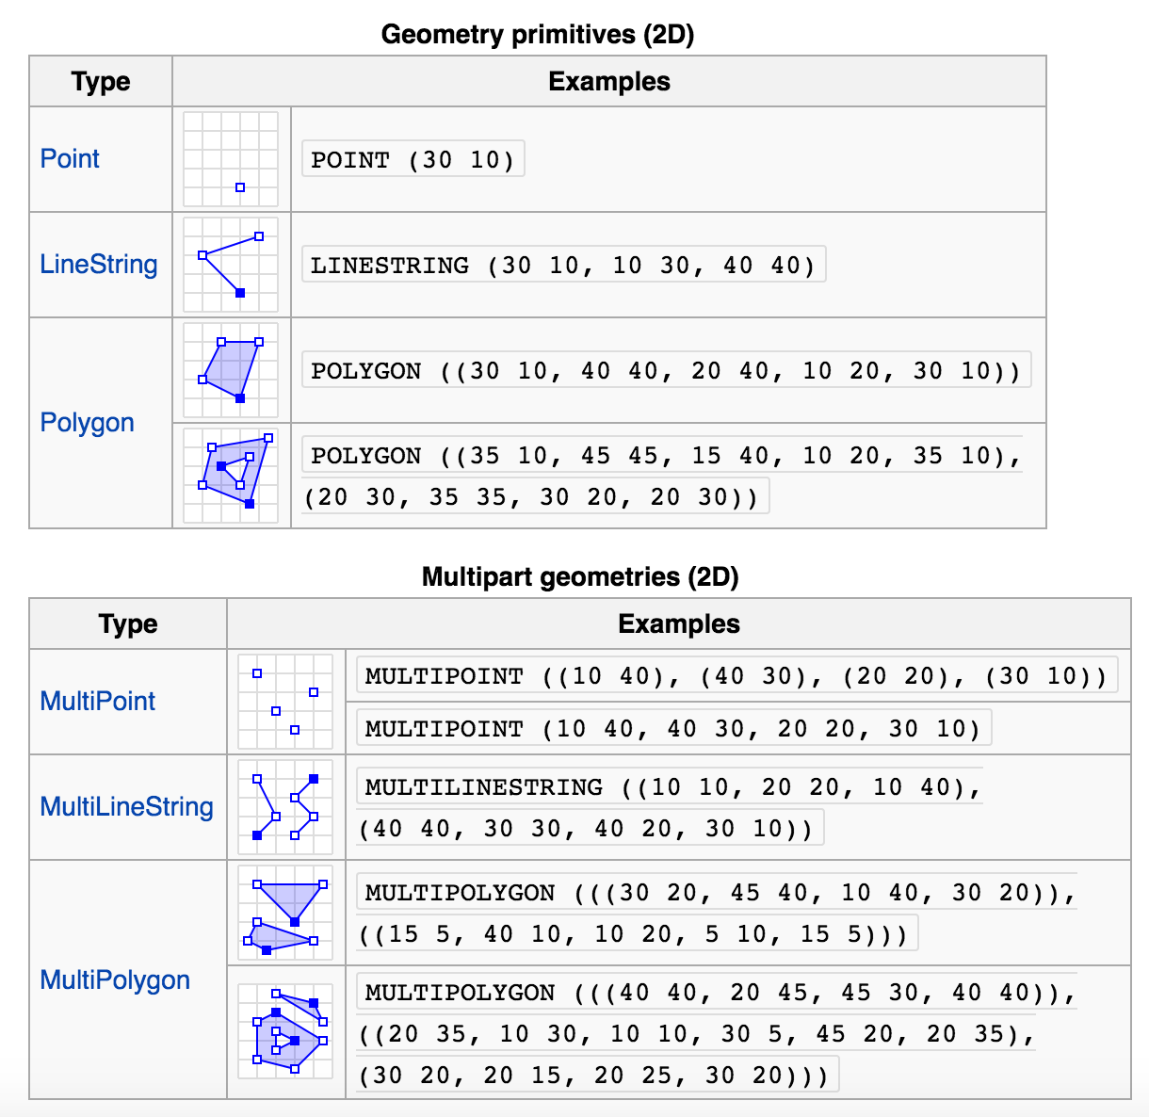
Quality control in OBIS

Slide 13
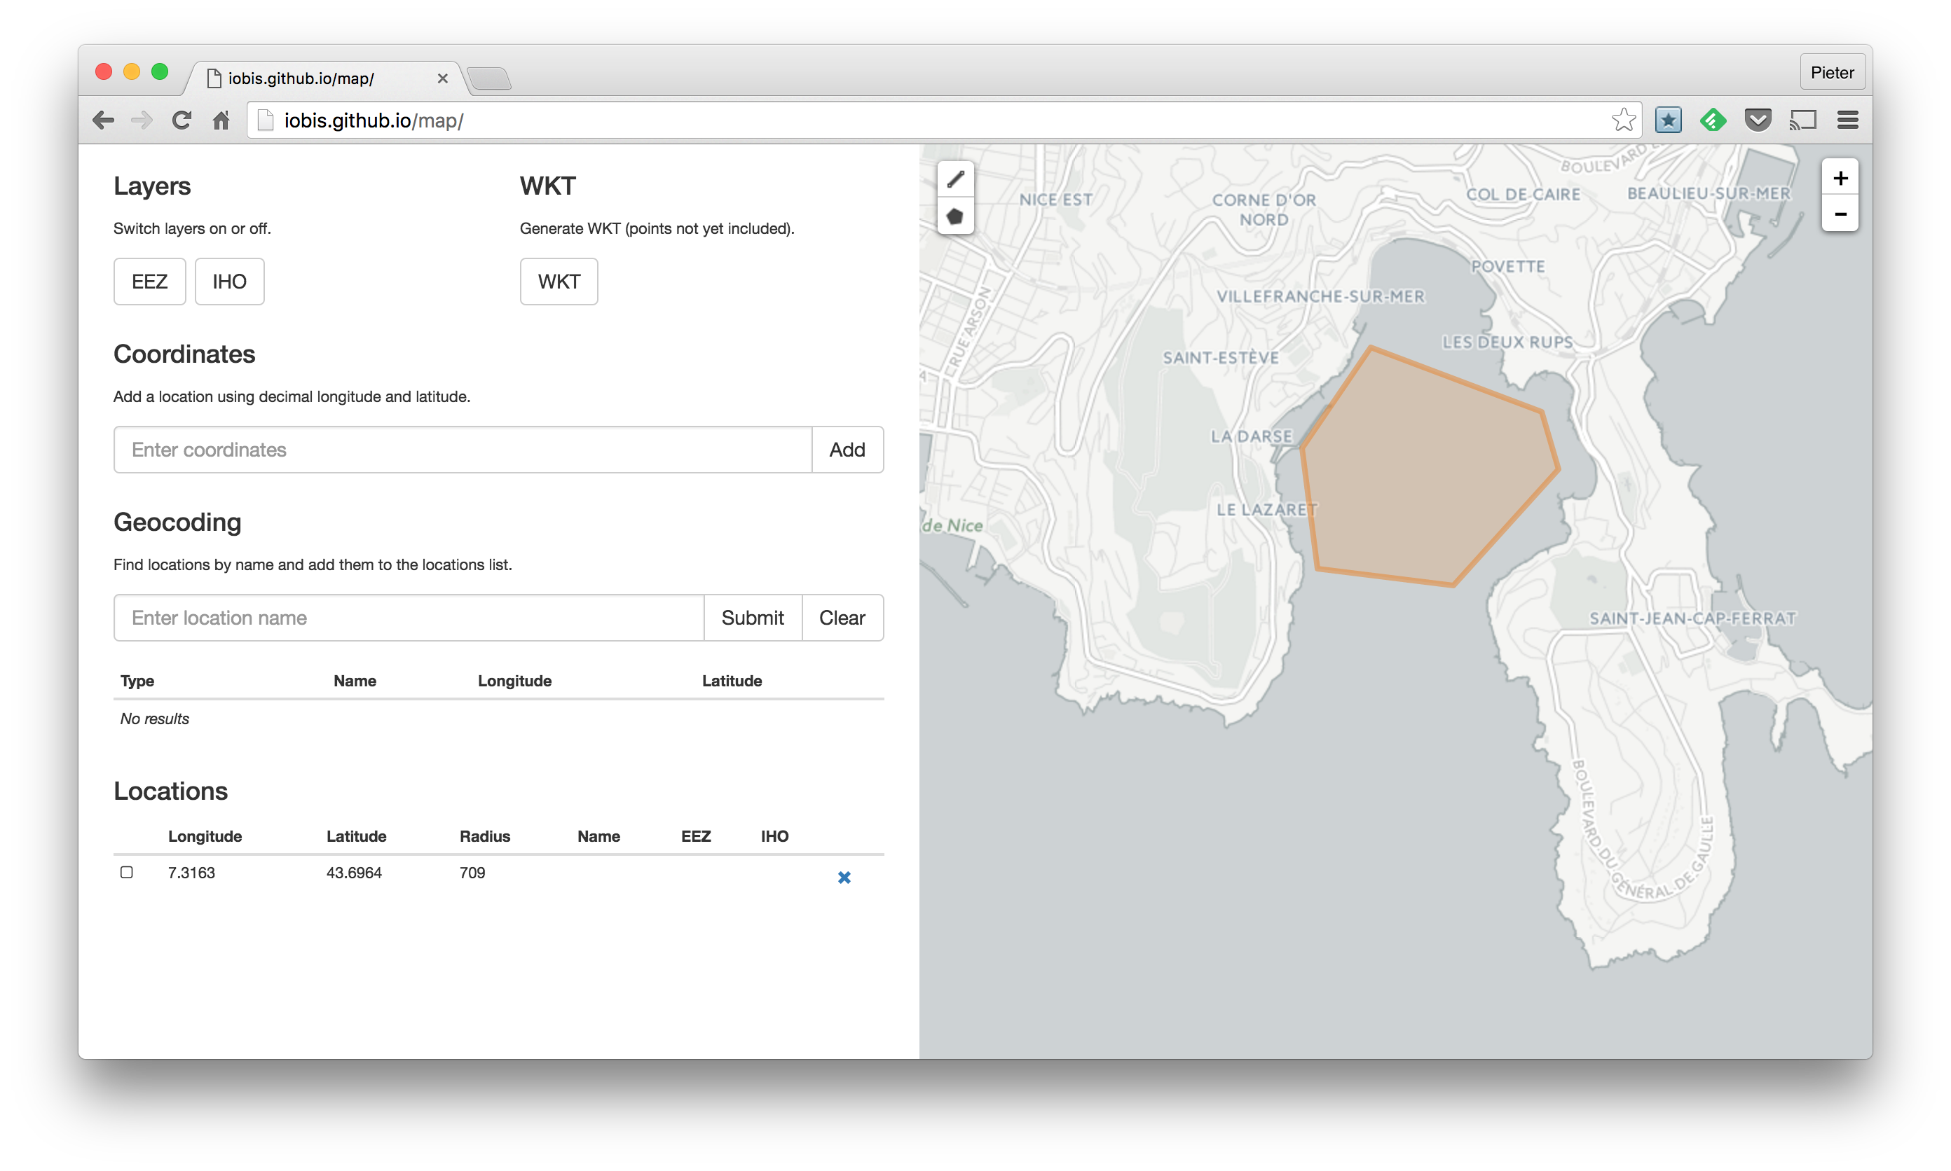
Quality control in OBIS

Slide 14
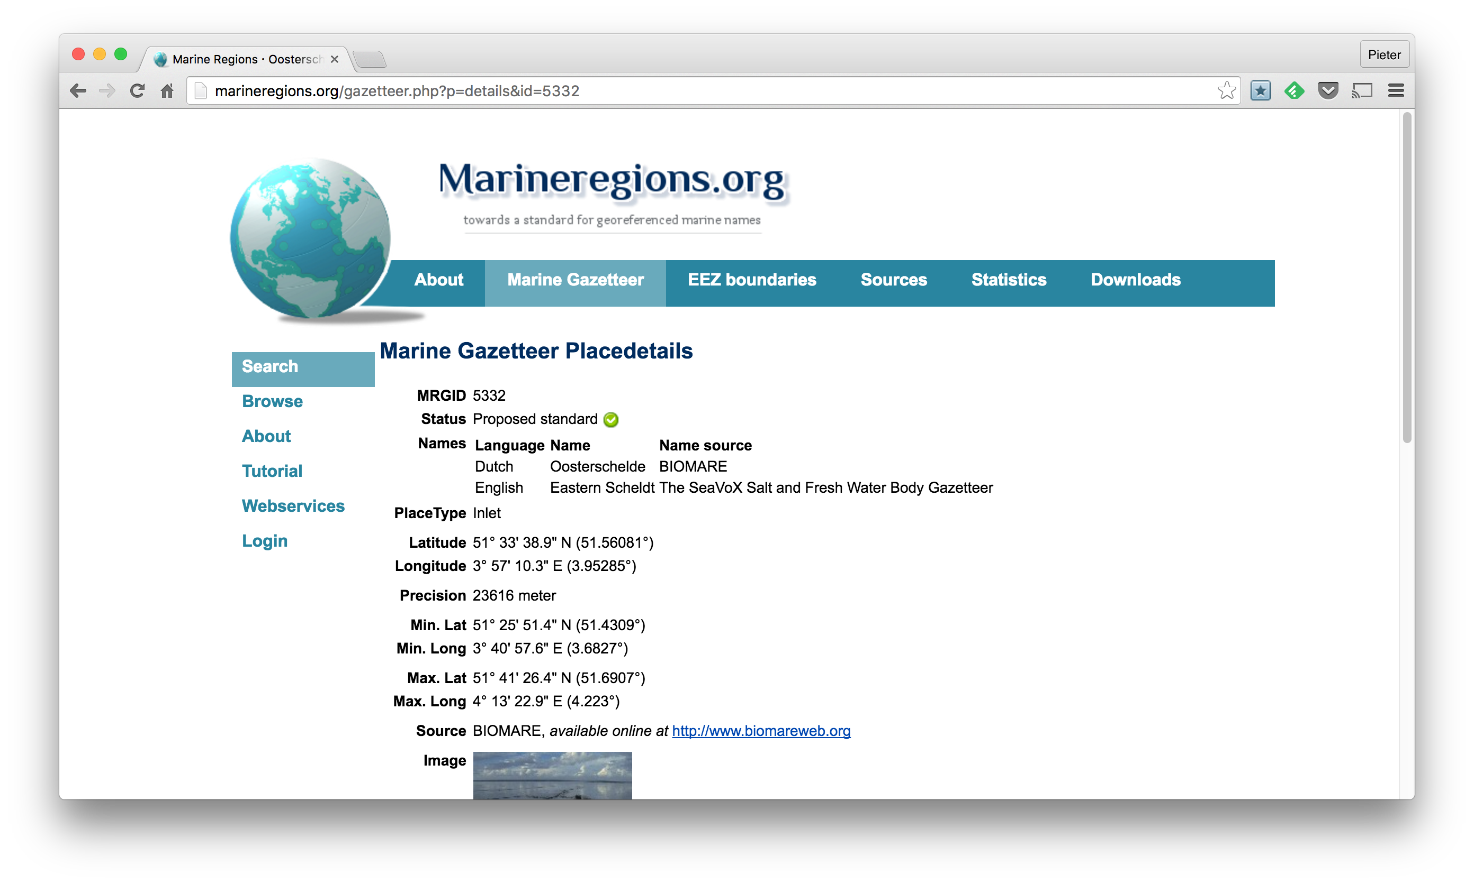
Quality control in OBIS

Slide 15
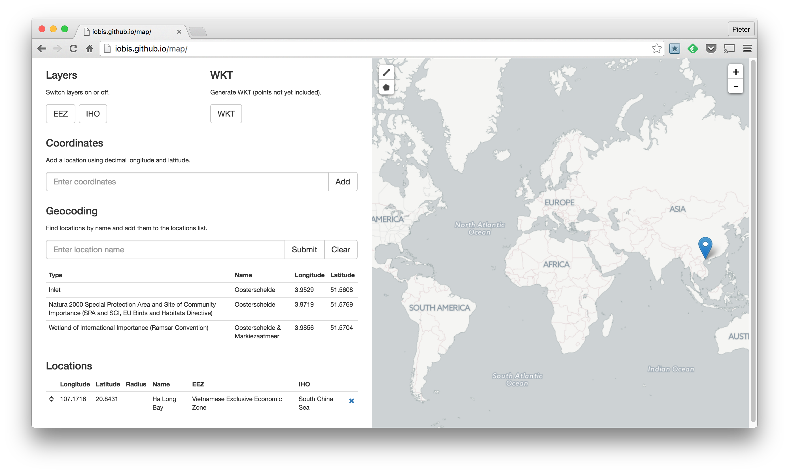
Quality control in OBIS

Slide 16
Quality control in OBIS
Not ok:
-54,00000
-550.244.444.444.444
-551.675
34.5673°
14°35’26’’N

Slide 17
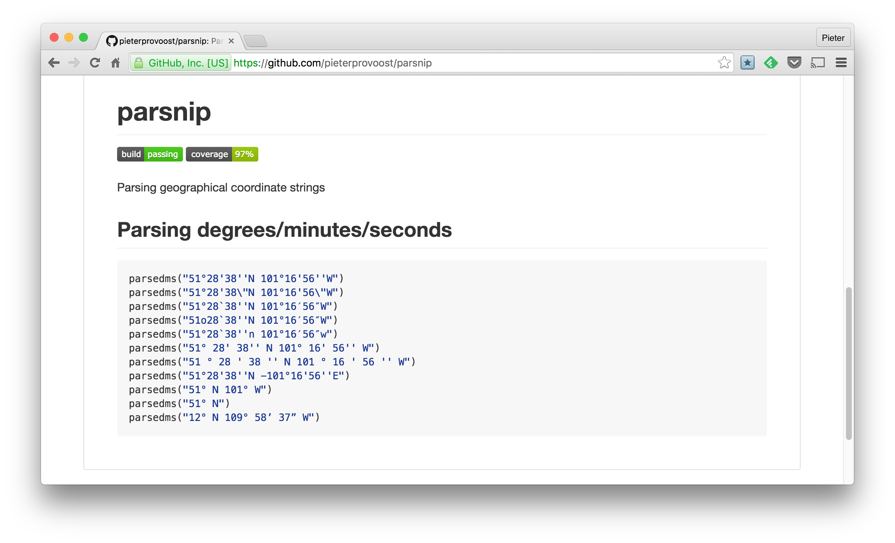
Quality control in OBIS

Slide 18
Quality control in OBIS
Make maps!

Slide 19
Quality control in OBIS
Make maps!

Slide 20
Quality control in OBIS
Make graphs!

Slide 21
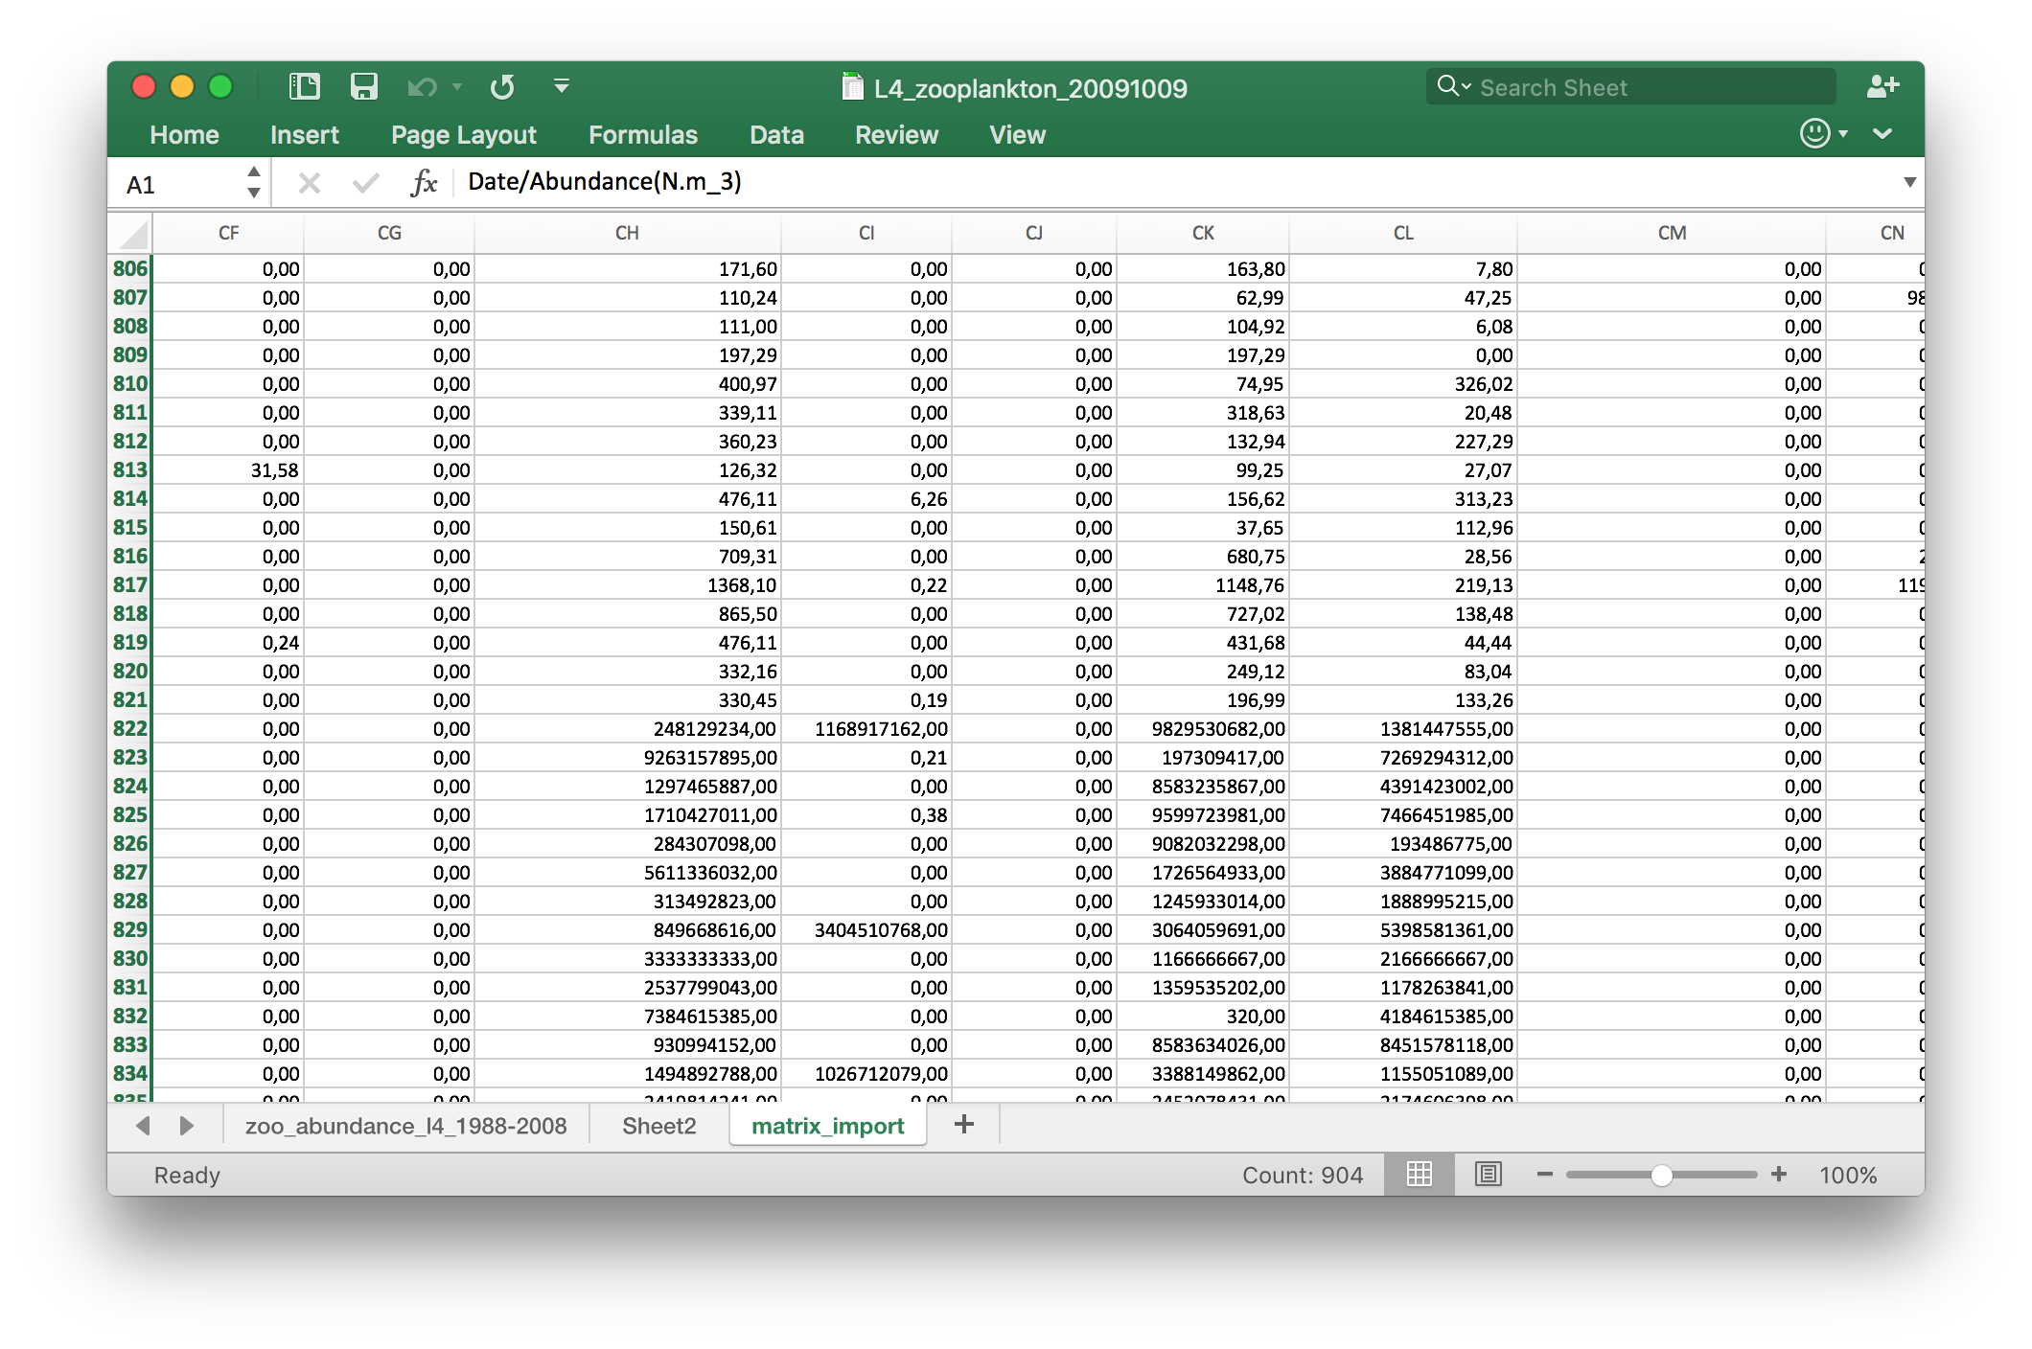
Quality control in OBIS
Make graphs!

Slide 22

Quality control in OBIS

Slide 23
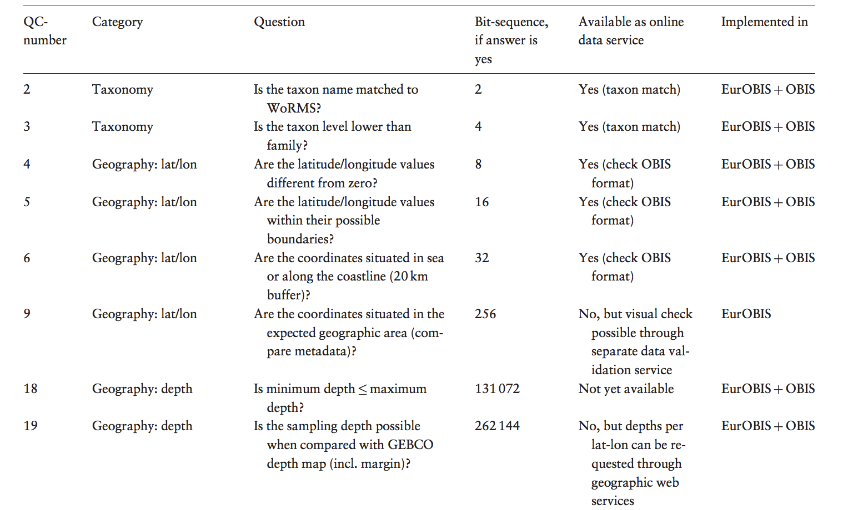
Quality control in OBIS

Slide 24
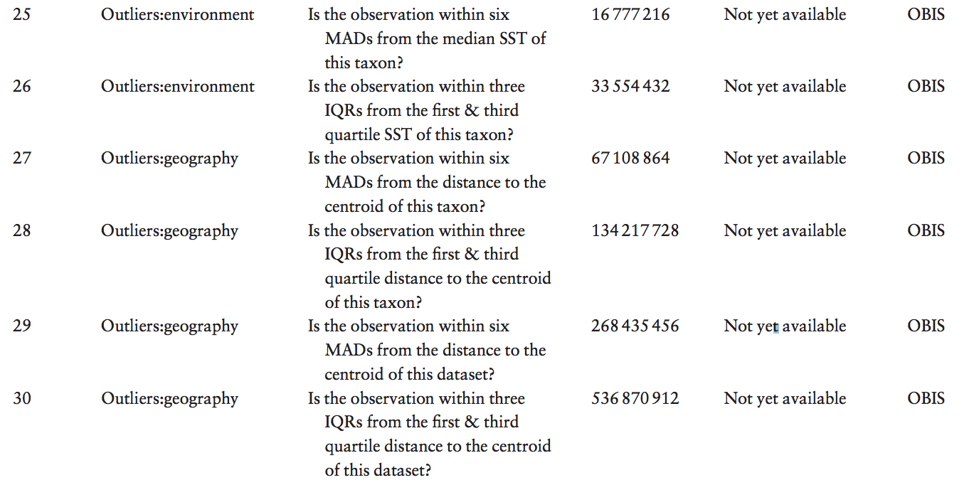
Quality control in OBIS

Slide 25
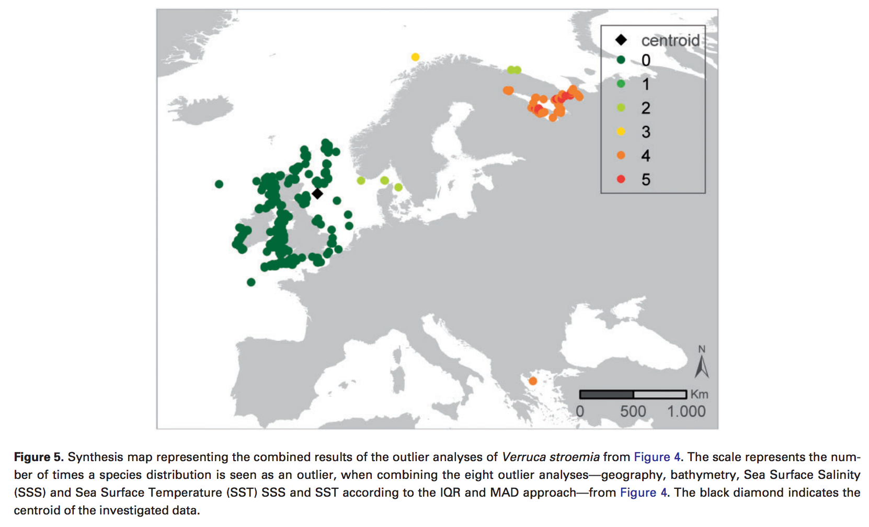
Quality control in OBIS

